Slide 1

DriverPass System Analysis
Victor Udeh
Notes:
Victor Udeh

Slide 2

System Requirements
Functional Requirements
The LMS should support various user roles such as Learners, Educators, and Administrators.
It should include a module dedicated to reporting.
Non-functional Requirements
It should feature a server architecture that can be easily scaled.
Users should be able to access the LMS via a web browser.
Notes:
To maintain data integrity and appropriate access levels within the Learning Management System, it's crucial to implement role-based permissions for different users such as Learners, Educators, and Administrators. This ensures specific capabilities, like lesson publication or student data management, are restricted to authorized roles.
For analytical and review purposes, the LMS will feature a robust Reporting module to enable Educators to digest and summarize educational data, including performance metrics over various timeframes.
As the user community expands, the LMS's server infrastructure must be scalable to handle increasing demands without compromising performance or data storage capabilities.
Finally, to facilitate accessibility and enhance user experience, the LMS will be accessible through standard internet browsers, supporting use on various devices, including laptops and mobile phones.

Slide 3
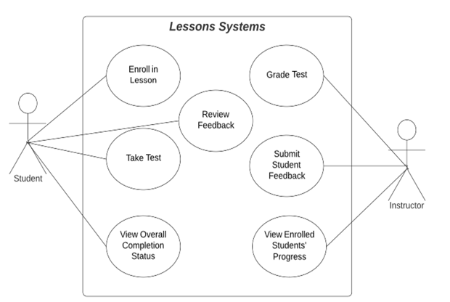
Use Case Diagram
The overarching LMS was segmented into smaller, more manageable sub-systems for better understanding. Clarity was further improved by developing use cases specific to these sub-systems. The subsequent slides will present these sub-systems in greater detail.
Notes:
The LMS's Lessons Sub-system is pivotal, acting as the central hub for Student-Instructor interaction, encompassing enrollment in lessons, feedback review, test-taking, and tracking completion.
Instructors are tasked with grading tests, providing feedback, and managing class rosters.

Slide 4
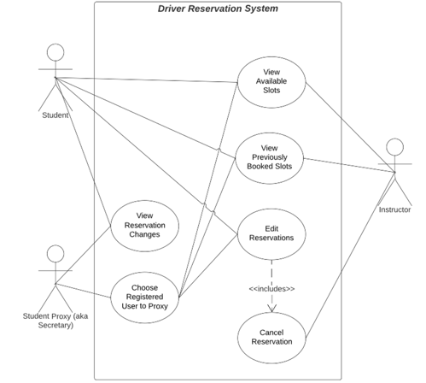
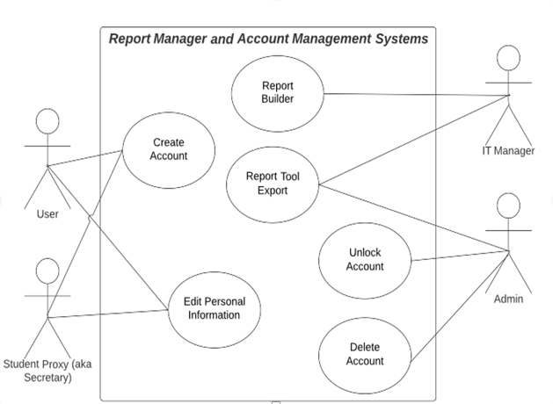
Use Case Diagram 2
Notes:
The JAD transcript indicates two student interaction methods with the LMS: enrolling in lessons, taking tests for theory comprehension, and reserving driving slots, involving Students, Proxies, and Instructors.
Proxy functionality is noted for secretarial assistance in enrollments, while Instructors may need to manage appointment cancellations due to various reasons.
Offline business analysis demands, as mentioned by Liam, require Reporting tools and a Report Management system for IT Managers and Admins to create and access reports.
Account management functions are necessary, including account creation, deletion, and unlocking. Additionally, secretarial proxies should assist with student information updates.

Slide 5
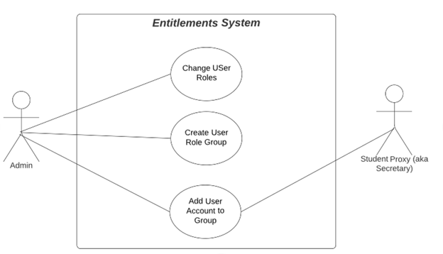
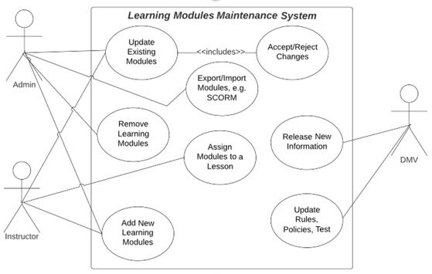
Use Case Diagram 3
Notes:
The transcript highlights the necessity for a Learning Module Maintenance system, emphasizing the need for content to stay current. This system would involve various roles: Admins, Instructors, and a regulatory body like the DMV. Instructors would be responsible for creating and updating lessons, while Admins would oversee the content, removing outdated materials, managing open-source module imports/exports, and validating any updates. An incident of incorrect or inappropriate content being uploaded underscores the need for such oversight. Additionally, a system based on role entitlements would govern permissions, ensuring a structured level of access and control within the LMS.

Slide 6
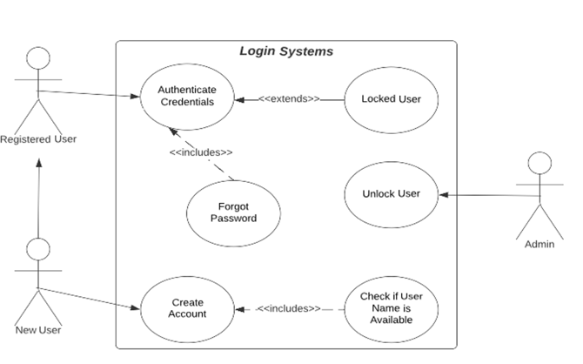
Use Case Diagram 4

Slide 7
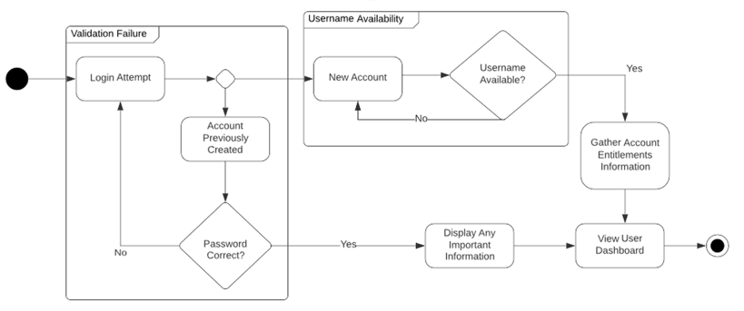
Activity Diagram
Notes:
The activity diagram depicts a user's login process, catering to both users with pre-existing access and those without, automating the process without the need for DRIVERPASS intervention. The system must ensure the uniqueness of account creation to prevent identity spoofing. Upon successful login, users are to be presented with the latest announcements before accessing their personalized User Dashboard, as described in the transcript.

Slide 8
Security
Each user will be designated a role, such as Learner, Educator, or Administrator.
Access rights, governed by the assigned role, will adhere to the Principle of Least Privilege.
System updates will be facilitated through the deployment of new software builds.
The use of copyleft licenses requiring the sharing of modified work will be avoided.
Encryption will protect all databases and routers, particularly those containing Personal Identifiable Information (PII).
APIs will utilize RSA-encrypted AES public keys for security.
Router traffic will be secured with TLS 1.2 protocol or a more advanced version.
Notes:
Maintaining system security is a collective responsibility that also extends to users. The system will incorporate a rights management structure to prevent unauthorized actions. Open-source licenses that could potentially reveal the codebase and its vulnerabilities will be avoided. Protecting personal information is critical, and encryption will be applied to safeguard such data, especially since certain jurisdictions have legal requirements for its handling. For secure data transmission, the system will use TLS 1.2 or newer protocols, as older versions like SSL and earlier TLS standards are becoming obsolete.

Slide 9
System Limitations
Assumptions:
Users will maintain a valid email account at all usage times.
Users will have access to a web-enabled device.
Limitations:
The system will not fully comply with ADA standards for blind users.
Deployment is limited to web server environments, not supporting FaaS or server-less architectures.
Notes:
Users will be authenticated through their email, which serves as a unique identifier to meet security and authentication protocols.
The system demands internet connectivity for access, prioritizing the importance of mobility and online availability for its users.
While the system aims for ADA compliance, initial versions will not cater to users with visual impairments.
The chosen server technology, whether proprietary or IaaS, will support the scalability requirements, favoring a monolithic framework that aligns with the engineering team's capabilities and expedites market delivery.

